Slide 1


Final Year Project
AI EYE GUIDE FOR VISUAL IMAPIRED PERSON
Supervised By: Ihtisham Ullah (Lecturer)

Slide 2
Project Team
Usama Ahsan (25279)
Muhammad Hassan (22956)
Suleman Amjad (24913)

Slide 3
Table of Content
Introduction and Background
Literature Review and Summary Table
Problem Statement
Methodology
Progress Report Summary
Requirements
Software System (Design + Implementation + Testing)
Endeavour (Team)
Next Steps
Prototype / Report

Slide 4
INTRODUCTION AND BACKGROUND

Slide 5
Introduction and Background
We are creating an application for visually impaired person to make their lives easier with the use of latest technologies
In the world, there are more than 2 billion people are visually impaired
Over user friendly interface will ensure that everyone can effortlessly access and enjoy the features of our application

Slide 6
Literature Review and Summary Table
 | Author | Domain | Date | Reference
1 | Ranjeet.P, Rahul Modi, Avinash.P, Ms. Jyoti B. Deone | Designing Mobile Application for Visually Impaired Person | 8, April, 2022 | https://papers.ssrn.com/sol3/papers.cfm?abstract_id=4108763

Slide 7
Summary Table
Apps | NoteTaking | Voice- Recorder | Speech- to- Text | AudioBook- Listening | Camera Translation | Accessible Documents sharing
AccessNote | ✓ | ✓ | ✖ | ✖ | ✖ | ✖
Dragon Dictation | ✖ | ✖ | ✓ | ✖ | ✖ | ✖
EverNote | ✓ | ✓ | ✓ | ✖ | ✖ | ✖
Kindle | ✓ | ✓ | ✖ | ✓ | ✖ | ✖
Google Translate | ✖ | ✖ | ✓ | ✓ | ✖ | ✖
Money Detector | ✓ | ✖ | ✓ | ✖ | ✓ | ✖
Object Detection | ✖ | ✖ | ✖ | ✖ | ✓ | ✖

Slide 8
Problem Statement
Visually impaired individuals face daily obstacles, such as accessing printed and digital information, understanding unfamiliar objects, and identifying currency banknotes.
These challenges can block their independence and access to education and employment opportunities.

Slide 9
Methodology
<Add diagram according to your project domain i.e., Methodology diagram (AI, IOT etc) OR Flow chart (Data Structures, Algorithms etc)>
<Also explain all steps in bullet points>

Slide 10
PROGRESS REPORT SUMMARY

Slide 11
Requirements
List of Different Users
Visually impaired person

Slide 12
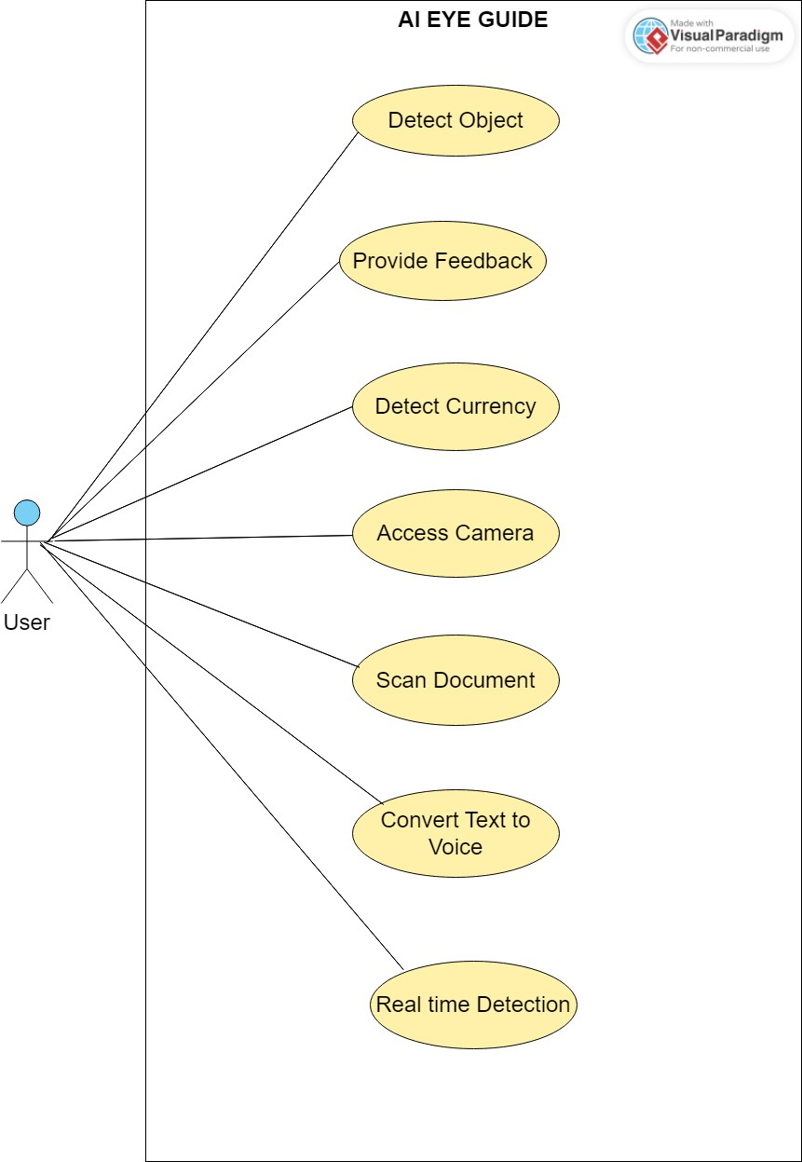
Requirements
Use Cases / User Stories:

Slide 13
Requirements
Functional Requirements
Object detection
Currency detection
Text to voice
Feedback

Slide 14
Requirements
Non functional requirements
Usability
Reliability
Performance
Scalability
Accessibility

Slide 15
Design
Deployment Diagram Representing Hardware/Software Components in your System

Slide 16
Design
Detailed Design (Optional based on your work)
UML Diagrams
ERD (if DB used)
etc.

Slide 17
Implementation
List Development Tools & Technologies
Android Studio
Visual Studio Code
GitHub
Microsoft Word
Microsoft PowerPoint
Google Colab
Pycharm

Slide 18
Implementation
List Best Practices / Coding Standards
Model View Controller Pattern
List Libraries / Components / Web Services
Flutter, Dart
Python, YOLO V8, RoboFlow, Open CV
Git

Slide 19
ENDEAVOUR

Slide 20
WBS
WBS # | WBS Deliverable | Activity # | Activity to Complete the Deliverable | Duration (# of Days) | Responsible Team Member(s) & Role(s)
1. | Feasibility study | 1 | Research work | 30 days | Muhammad Hassan, Usama Ahsan, Suleman Amjad
2. | Development of application | 2 | Creating all screen | 45 days | Usama Ahsan

Slide 21
WBS
3. | Currency detection | 3 | developing module of currency detection | 50 days | Muhammad Hassan, Usama Ahsan, Suleman Amjad
4. | Object detection | 4 | Developing module of object detection | pending | Muhammad Hassan, Usama Ahsan, Suleman Amjad
5. | Text to voice | 5 | Developing text to voice module | pending | Muhammad Hassan, Usama Ahsan, Suleman Amjad
6. | Report writing | 6 | Documentation of project | 50 days | Muhammad Hassan, Usama Ahsan, Suleman amjad

Slide 22
NEXT STEPS

Slide 23
Work Breakdown Structure (List of all Deliverables / Strikethrough Completed Deliverables)
Frontend
Frontend First half of screens
Front Second half of Screens
AI Model Currency detection
Find Data Set
Create Model
Train model with the set
Integrate In The Application
AI Model Object detection
Find Data Set
Create Model
Train model with the set
Integrate In The Application
AI Model Text to voice
Find Data Set
Create Model
Train model with the set
Integrate In The Application

Slide 24
Work Breakdown Structure (List of all Deliverables / Strikethrough Completed Deliverables)
Backend
Integrate AI Model Currency detection In The Application
Integrate AI Model Object detection In The App
Integrate AI Model Text to voice In The App

Slide 25
Challenges
Dataset Finding
Dataset annotation and segmentation
Finding tool for annotation
Model Training

Slide 26
PROTOTYPE & REPORT

Slide 27
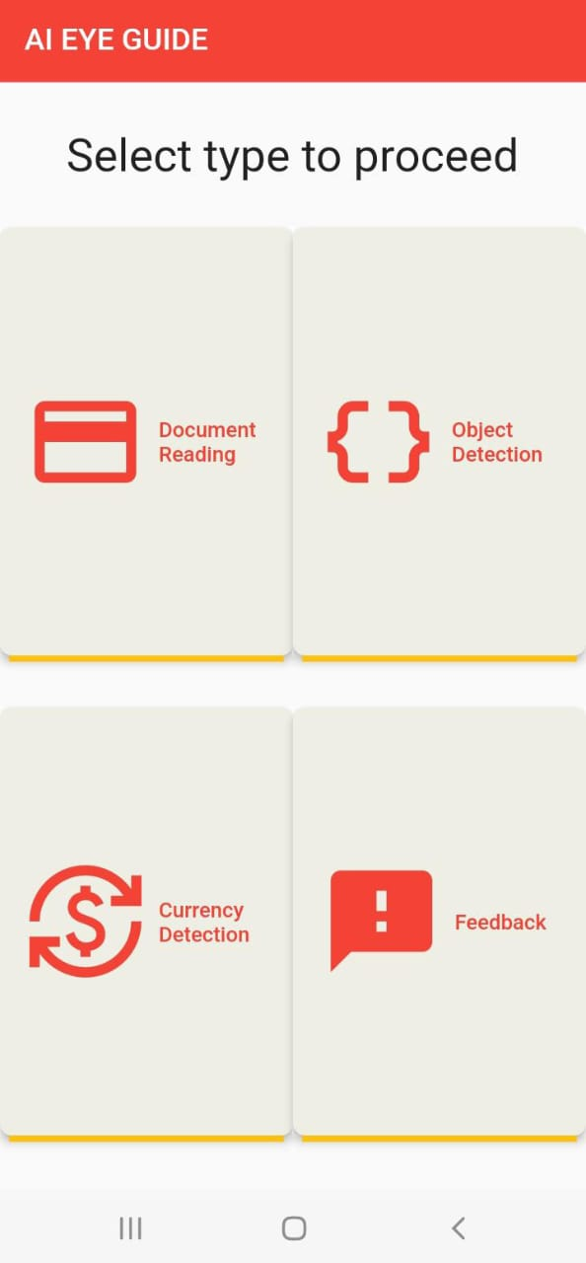
Prototype

Slide 28
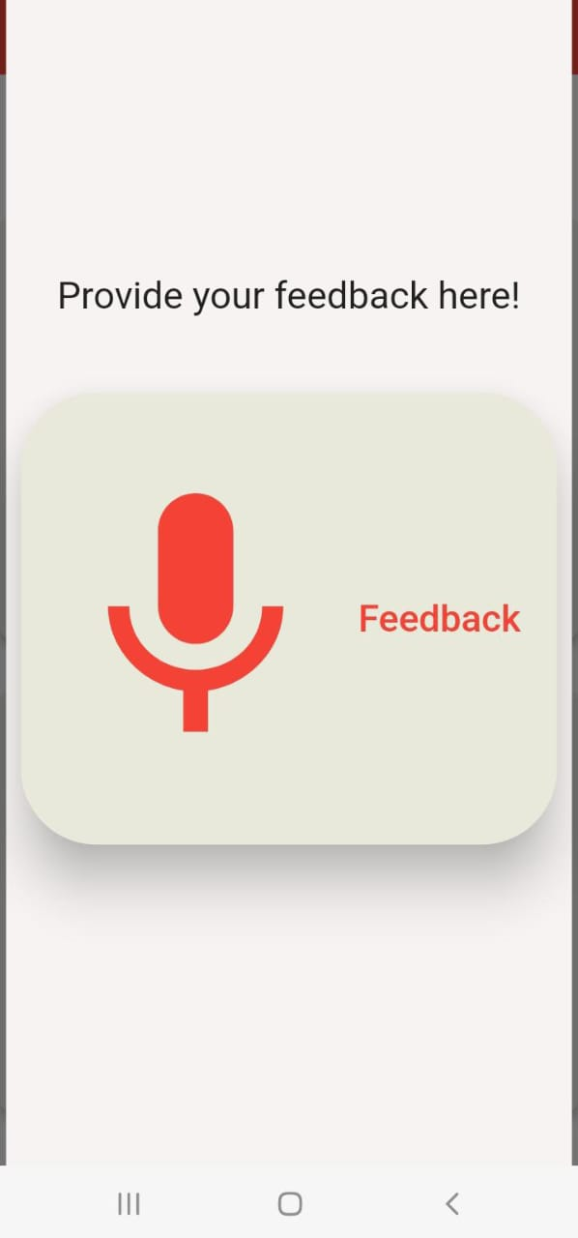
Prototype

Slide 29
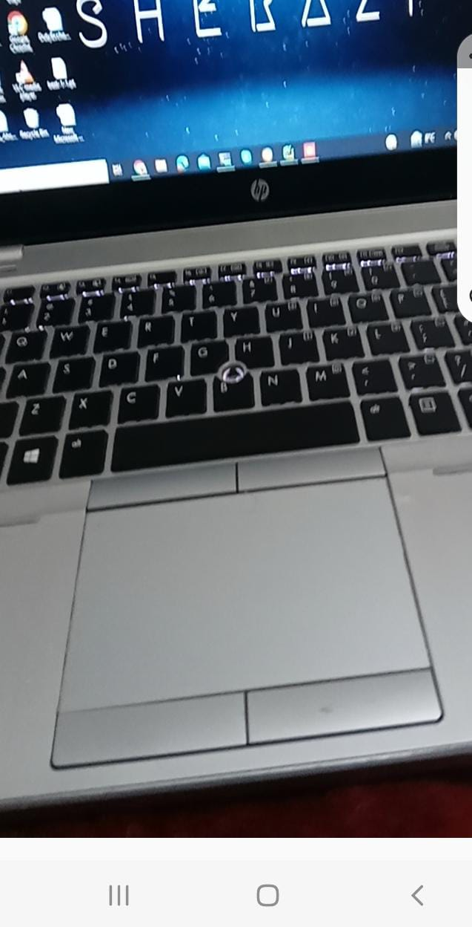
Prototype

Slide 30
Report
Chapter 1: Introduction
Chapter 2: Literature Review / Market Survey
Chapter 3: Requirements and Design
Chapter 4: Implementation and Test Cases
Chapter 5: Experiment Results and Analysis
Chapter 6: Conclusion & Future Direction

